Slide 1
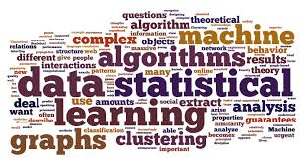
評論分類器- Comment Filter
成員 :
10227215 祝銘
10227221 黃礪鞍
指導教授: 柯士文
Notes:
Good afternoon.
Here is our project . Comment Filter
My name is Li-An . He is Chu-Ming
Our advisor is George .

Slide 2
Outline
Abstraction
Research motive
Flow chart
Tool
Analysis report
Retrospect and prospect
Notes:
This is our outline .
We’ll talk about these topics .

Slide 3
Abstraction
It is a generation of a cyber . Any issue , blog ,video or tweet be post on internet can be anyone discussed . Sometimes people post a comment on it . However Some Advertisers make some Commercial Message by program That we call Machine Spam . We found the comments were reported would create a “spam label”, but we cannot recognize which comment is machine spam or human spam . Therefore, our project is devoting to distinguish between human comment and machine spam precisely. We also use feedback that provided by user to retrain our model .
Notes:
Let’s talk about the Abstraction .
No matter Facebook 、 twitter and youtube , these social media use internet .
All of them , providing the function of replying .
However , some of programmers make lots of Commercial messages .
These messages result in users annoying .
Therefore , our project want to distinguish between human comments and machine comment .
Also providing the function of feedback , which can adjust our prediction model by users .

Slide 4
Outline
Abstraction
Research motive
Flow chart
Tool
Analysis report
Retrospect and prospect
Notes:
The research motive

Slide 5
Research motive
Spam: Spam is bad comment reported by user including some dirty word or something else
Machine Spam: spam—also known as junk comment—is a type of electronic spam where unsolicited messages are posted by Machine . Many Machine are commercial in nature but may also contain disguised links that appear to be for familiar websites but in fact lead to phishing web sites or sites that are hosting malware
Notes:
First , we explain some words .
Spam means : the bad comment may make someone uncomfortable .
Machine Spam is as known as junk comment . It spreads by program and the feature in the machine comments is often appearing the link which is phishing web sites .

Slide 6

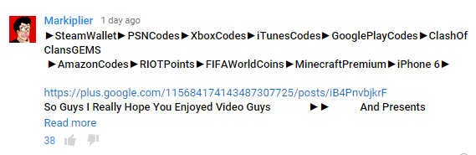
Research motive
Example
Notes:
Here is the example about commercial comments , and this is why we want to solve this problem .

Slide 7
Outline
Abstraction
Research motive
Flow chart
Tool
Analysis report
Retrospect and prospect
Notes:
The flow chart

Slide 8
Flow chart-Concept
We use SVM to create a Comment Filter model . Comments of Youtube Video as input will be scanned by model and generate a Label about Classification . Our System include Function of feedback that can let user help us to retrain our model to increase Accuracy about result
Notes:
Let’s talk about concept .
We use SVM to create a prediction model .
The model label the comments if it is a machine comments .
Finally , we collect the feedback by users to retrain our model and make it more correctly .

Slide 9
Flow chart- Pre-job
Collect a lot of comments from youtube
Do some Shallow Processing with comment
Create Model
Notes:
The pre-job is like this .
Collect a lot of comments && do some work then be a Model .

Slide 10
Flow chart- Implementation
Enter the Key to search video you want
Save the record about feedback . Set schedule in server to retrain SVM model every day
Return the result to user interface
Click Video
yes
Return Video and result of analysis
Feedback
No
End
Notes:
Here is the implementation .
1.User can search the video they want , just like youtube . And we will return the video and make user to choose .
2.When user choose the video , we will analysis the comments of this video . We separate the machine comments from it .
3.User can feedback us , and we retrain our model by these feedback everyday .

Slide 11
Outline
Abstraction
Research motive
Flow chart
Tool
Analysis report
Retrospect and prospect
Notes:
The Tool

Slide 12

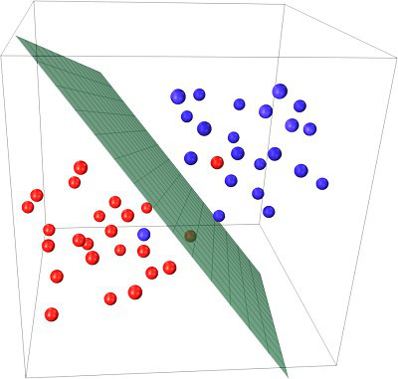

Tool
YoutubeAPI + BeautifulSoup
SVM
Django
Notes:
About tool, we use YoutubeAPI , SVM , Django. YoutubeAPI is a Application Programming Interface provided by google . It can help us to access particular Data from youtube Database like videos , comments or something else.
BeautifulSoup is a Python package . Crawler is the major function of BeautifulSoup.
SVM is an algo about machine learning . You need some training data to create SVM model , and keep training with new data . The result will be more accurate .
Django is a kind of web framework developed by python and It is our major tool of user interface

Slide 13
Outline
Abstraction
Research motive
Flow chart
Tool
Analysis report
Retrospect and prospect
Notes:
Analysis report

Slide 14
analysis report-1
M% = $\frac{Number of M− M Mistake}{Number of M}$ NM% = $\frac{Number of NM− NM Mistake}{Number of NM}$
 | Number of video | Number of comment | Number of Machine Spam | Number of Non Machine Spam | M Mistake | NM Mistake | Number of Mistake | M% | NM%
Correct answer | 50 | 9453 | 58 | 9395 | 0 | 0 | 0
Original | 50 | 9453 | 122 | 9331 | 86 | 22 | 98 | 29.5% | 99.70%
First Retraining | 50 | 9453 | 106 | 9347 | 67 | 19 | 86 | 36.7% | 99.79%
Second Retraining | 50 | 9453 | 97 | 9356 | 55 | 16 | 71 | 43.2% | 99.82%
^{[1]} Machine mistake : Number of Machine Spam that user feedback
^{[2]} Not Machine mistake : Number of Non Machine Spam that user feedback
^{[3]}Number of mistake:Number of feedback
Notes:
Here is our analysis report
First,we choose 50 most popular videos in USA an there are 9453 comments .
We use our Original model to predict those comments are Machine Spam or not . And our Correct rate is about 30 % at first. It is not a good number But when we put those mistake into out SVM model as input to retraining model .the Correct rate improve to about 35%.third time the Correct rate even improve to about 45 % .So we believe the way how we retraining is effective if we have correct feedback.

Slide 15
analysis report-2
Notes:
Here is our statistical graph. With this graph we can know the mistake rate is decreasing when we retrain the model .

Slide 16
Outline
Abstraction
Research motive
Flow chart
Tool
Analysis report
Retrospect and prospect
Notes:
Retrospect and prospect

Slide 17
Retrospect and prospect
Although the accuracy of SVM is not bad but not good enough . We expect that we can alter the prediction model to increase accuracy about result . Maybe we will choose other better Algo .If our accuracy is better than before we expect that our system can be promoted to other community website to eradicate Spam in social network.
Notes:
Although the accuracy of SVM is not bad but not good enough . We expect that we can improve our correct rate in other way not just retraining . Maybe we will change the algo to achieve this goal . If our result is more correctly than before we expect that our project can eliminate the problem about Machine Spam.

Slide 18
Thanks for listening

